Slide 1
DLL Doubly Linked List
Insert end
Traverse
Delete specific

Slide 2
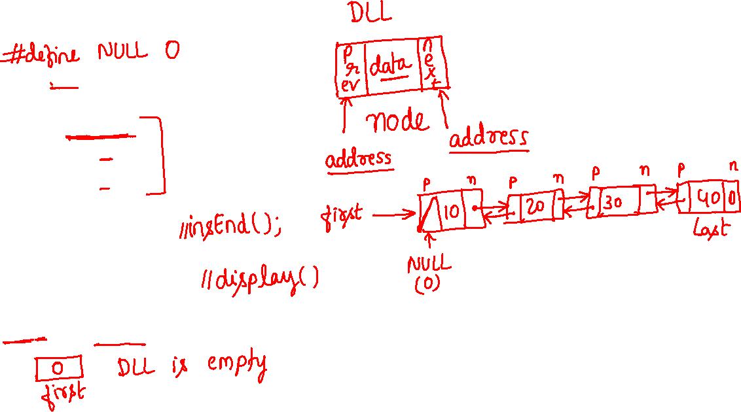
DLL 1/7
class list
{
int data;
list *next;
list *prev;
public:
void create();
void delSpecific();
void traverse();
};
list *first=NULL;

Slide 3
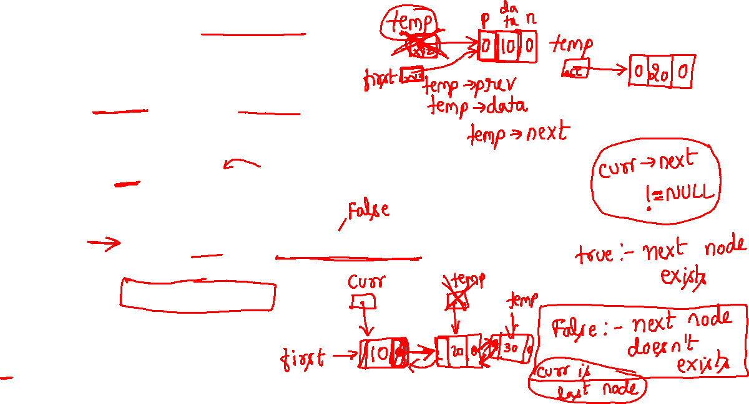
DLL 2/7 1. Create or insert End
void list::create()
{
list *temp; temp=new list;
cout<<"\nenter the data:"; cin>>temp->data;
temp->prev=NULL; temp->next=NULL;
if(first==NULL) first=temp;
else
{
for(list *curr=first;curr->next!=NULL;curr=curr->next);
curr->next=temp;
temp->prev=curr;
}
traverse();
}

Slide 4
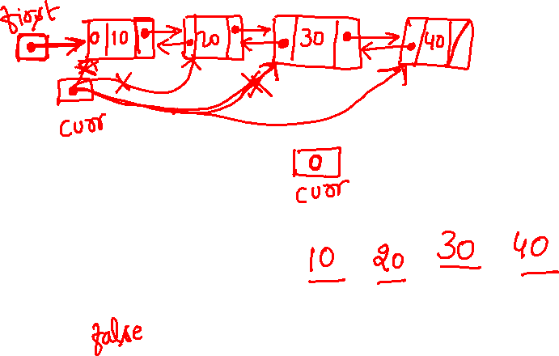
DLL 3/7 2. Traverse
void list::traverse()
{
if(first==NULL)
cout<<"\nlist is empty";
else
{
cout<<"\nthe list is:\n";
for(list *curr=first;curr!=NULL;curr=curr->next)
cout<<curr->data<<"\t";
}
}

Slide 5
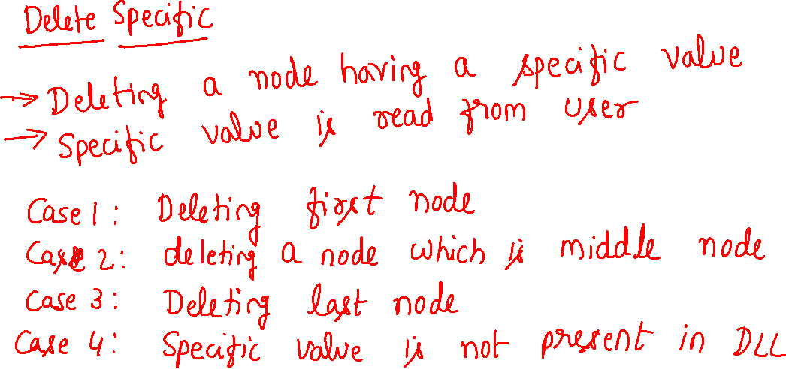

Slide 6
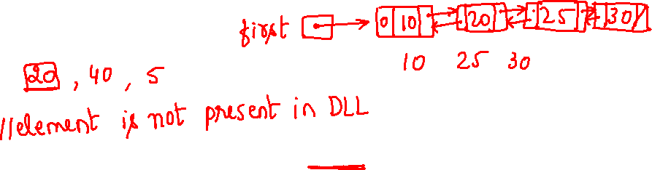
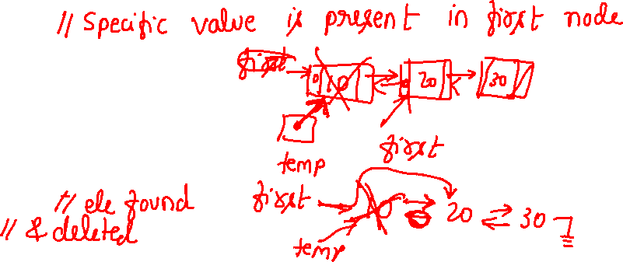
DLL 4/7 5. Delete specific 1/3
void list::delSpecific()
{
int x,flag=0;
cout<<"\nenter the element to be deleted:"; cin>>x;
if(first==NULL) cout<<"\nlist is empty";
else if(first->data==x)
{
list *temp=first;
first=first->next;
first->prev=NULL;
delete temp;
flag=1;
}

Slide 7
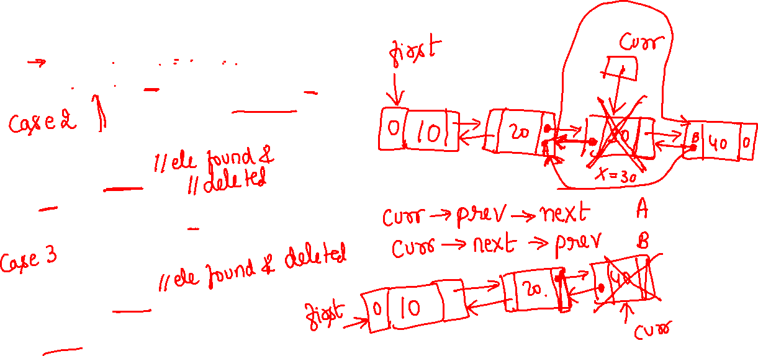
DLL 5/7 5. Delete specific 2/3
else
{
for(list *curr=first;curr!=NULL;curr=curr->next){
if(curr->data==x&&curr->next!=NULL){
curr->prev->next=curr->next;
curr->next->prev=curr->prev;
delete curr;
flag=1;
break;
}
else if(curr->data==x){
curr->prev->next=NULL;
delete curr;
flag=1;
break;
}
}//for
}//else

Slide 8
DLL 6/7 5. Delete specific 3/3
if(flag==0)
cout<<"\nnode not found\n";
traverse();
} // delSpecific()

Slide 9

DLL 7/7 main
void main()
{ list l; int ch;
do
{
cout<<"\n1. create2. delete specific \n 3. traverse \n0.exit";
cout<<"\nenter your choice:"; cin>>ch;
switch(ch) { case 1:l.create();break;
case 2:l.delSpecific();break;
case 3:l.traverse();break;
case 0:break;
default:cout<<"\ninvalid input";break;
} }while(ch!=0);
}

Slide 10
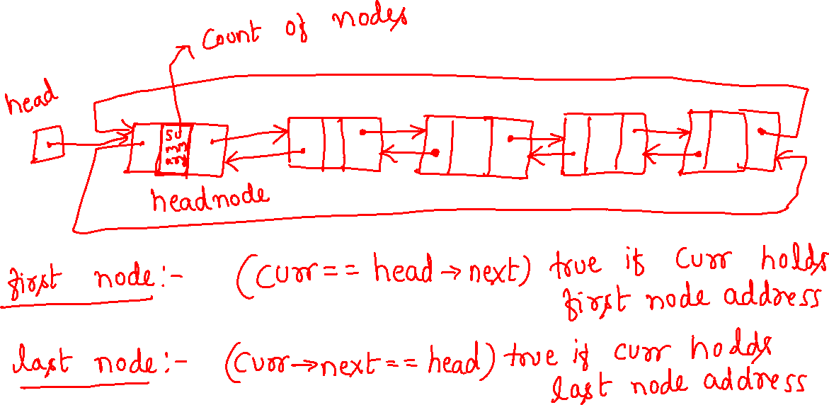
CDLL with head node

Slide 11
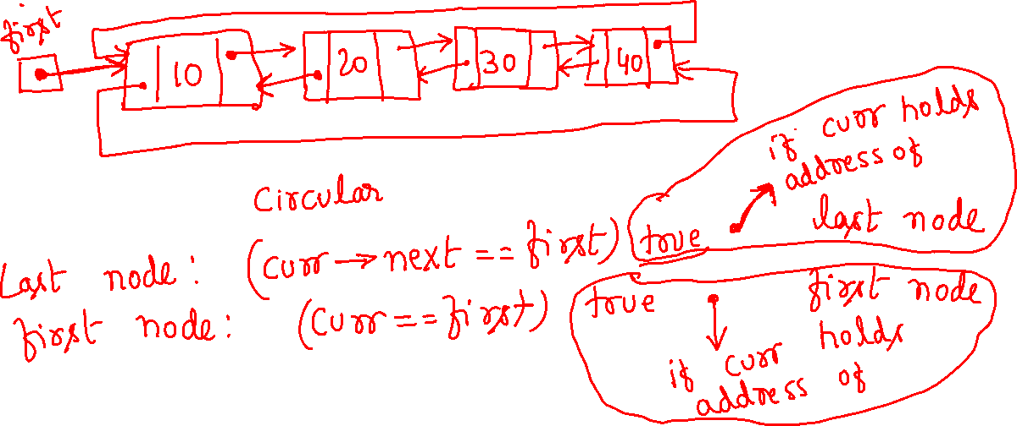
CDLL without head node

Slide 12


Trees

Slide 13
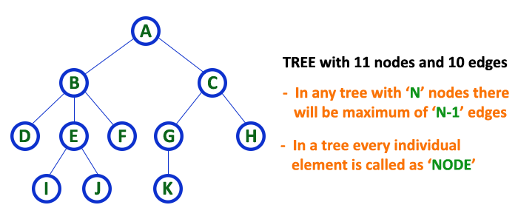
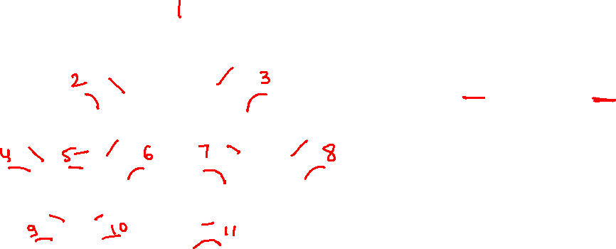
Introduction
A tree structure means that the data are organized so that items of information are related by branches
Examples:

Slide 14
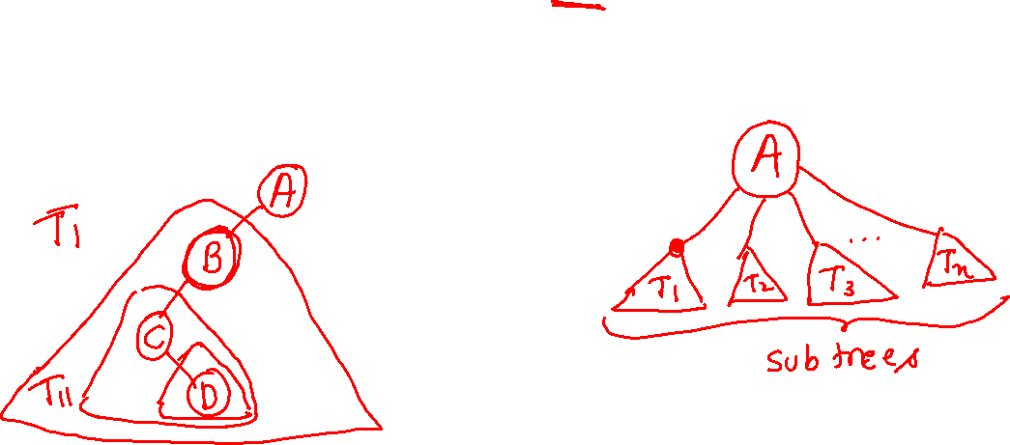
Introduction
Definition (recursively): A tree is a finite set of one or more nodes such that
There is a specially designated node called root.
The remaining nodes are partitioned into n>=0 disjoint set T₁,…,T_{n}, where each of these sets is a tree. T₁,…,T_{n} are called the subtrees of the root.
Every node in the tree is the root of some subtree

Slide 15
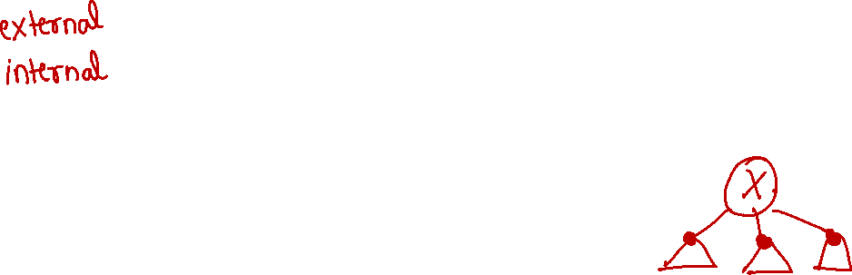
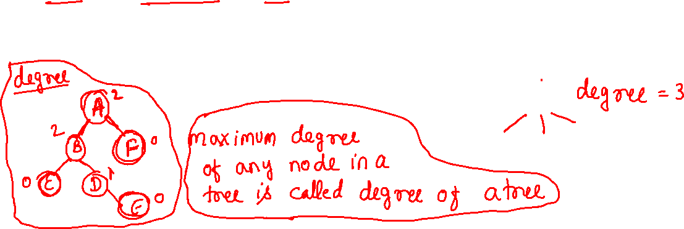
Introduction
Some Terminology
node: the item of information plus the branches to each node.
degree: the number of subtrees of a node
degree of a tree: the maximum of the degree of the nodes in the tree.
terminal nodes (or leaf): nodes that have degree zero
nonterminal nodes: nodes that don’t belong to terminal nodes.
children: the roots of the subtrees of a node X are the children of X
parent: X is the parent of its children.

Slide 16
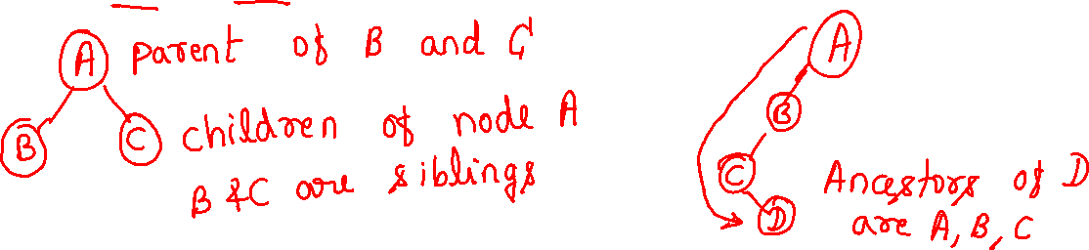
Introduction
Some Terminology (cont’d)
siblings: children of the same parent are said to be siblings.
Ancestors of a node: all the nodes along the path from the root to that node.
The level of a node: defined by letting the root be at level one. If a node is at level l, then it children are at level l+1.
Height (or depth): the maximum level of any node in the tree

Slide 17
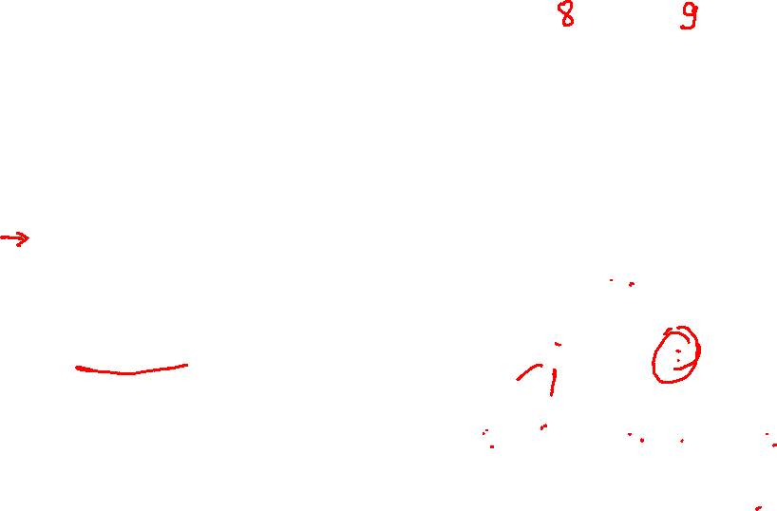
Introduction
Example
A is the root node
B is the parent of D and E
C is the sibling of B
D and E are the children of B
D, E, F, G, I are external nodes, or leaves
A, B, C, H are internal nodes
The level of E is 3
The height (depth) of the tree is 4
The degree of node B is 2
The degree of the tree is 3
The ancestors of node I is A, C, H
The descendants of node C is F, G, H, I
Property: (# edges) = (#nodes) - 1
Level
A
1
B
C
2
H
3
D
E
F
G
I
4

Slide 18
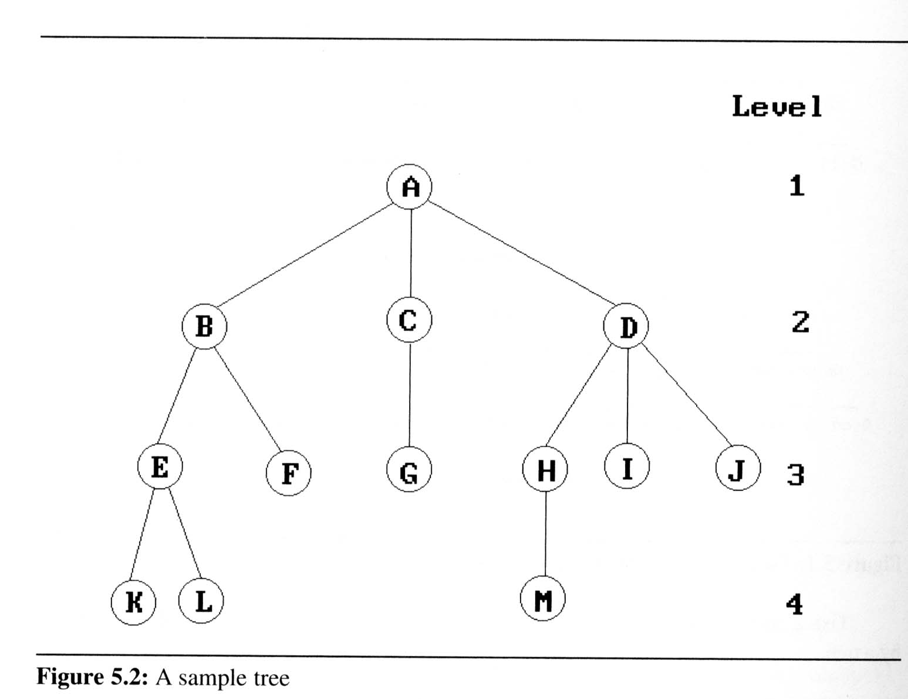
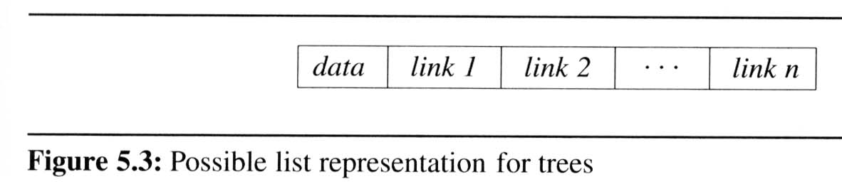
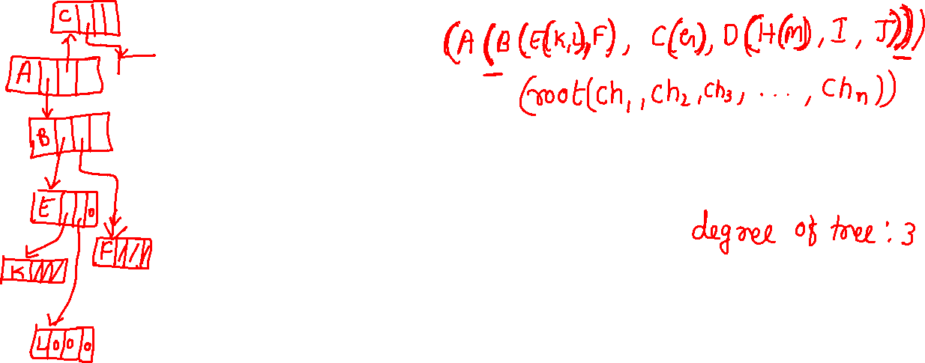
Introduction
Representation Of Trees
List Representation
we can write of Figure 5.2 as a list in which each of the subtrees is also a list
( A ( B ( E ( K, L ), F ), C ( G ), D ( H ( M ), I, J ) ) )
The root comes first, followed by a list of sub-trees

Slide 19
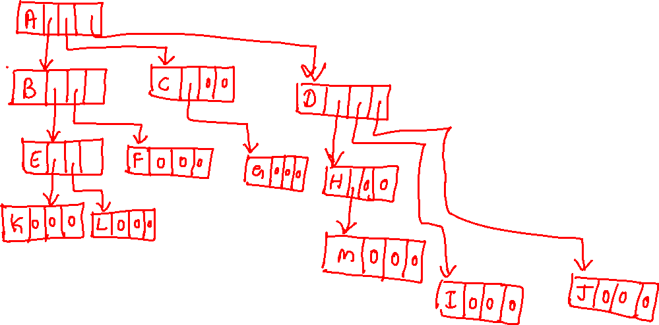

Slide 20
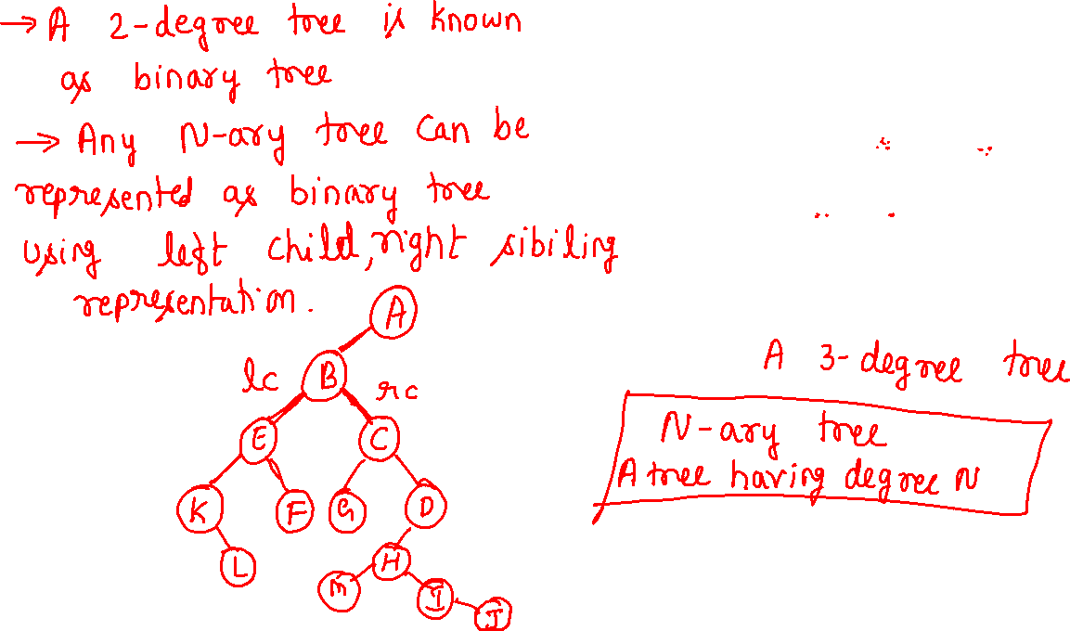

Slide 21
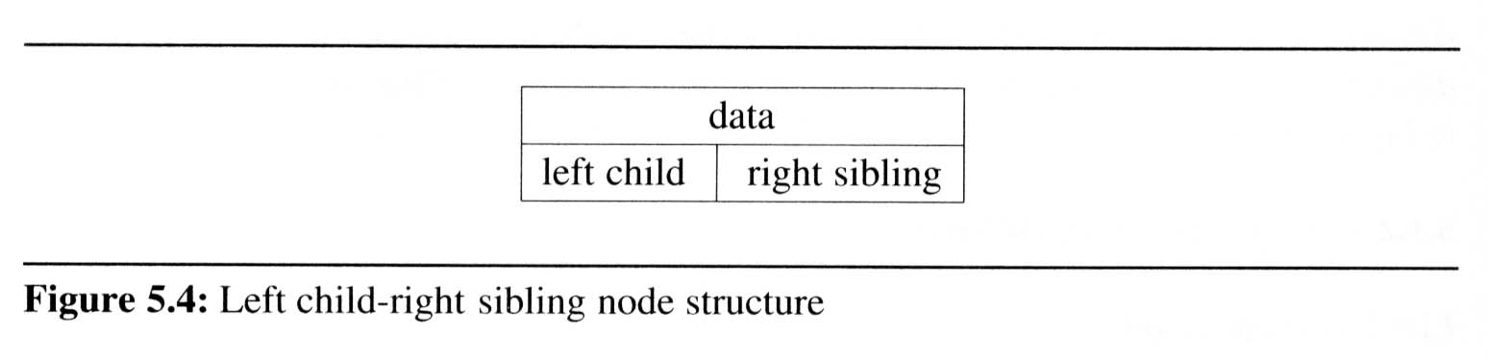
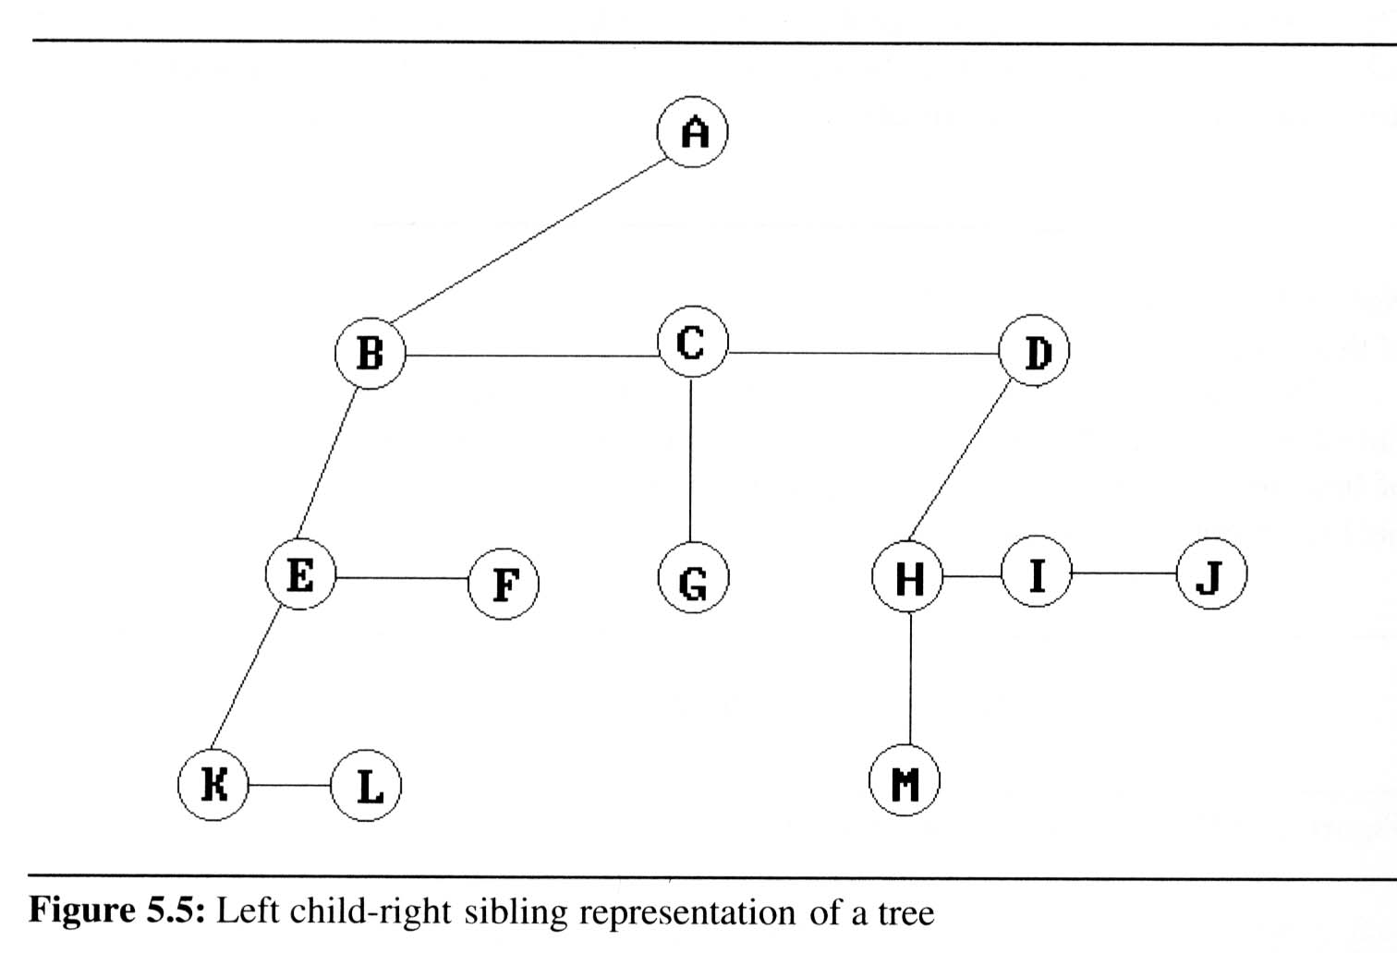
Introduction
Representation Of Trees (cont’d)
Left Child- Right Sibling Representation

